Slide 1
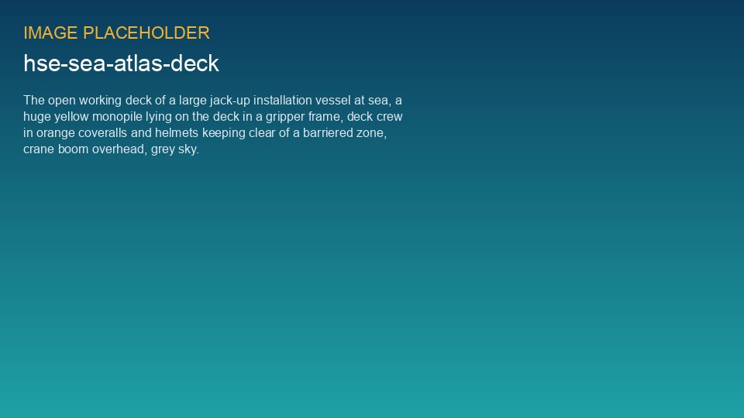
WEYLAND ENERGY
Dropped objects – it only takes one
Toolbox talk · safety stand-down 4 June 2026

Slide 2
What happened on 3 June
• 2.3 kg ratchet spanner fell about 22 m on MV Sea Atlas
• Bounced off a handrail and landed 2.5 m from a colleague
• Nobody was hurt – this time
• Reference: HSE-INC-2026-018
WEYLAND ENERGY · Toolbox Talk – Dropped Objects
2

Slide 3
How dangerous is it?
496 J
Fatal
2.5 m
Impact energy
DROPS category
Distance to person
WEYLAND ENERGY · Toolbox Talk – Dropped Objects
3

Slide 4
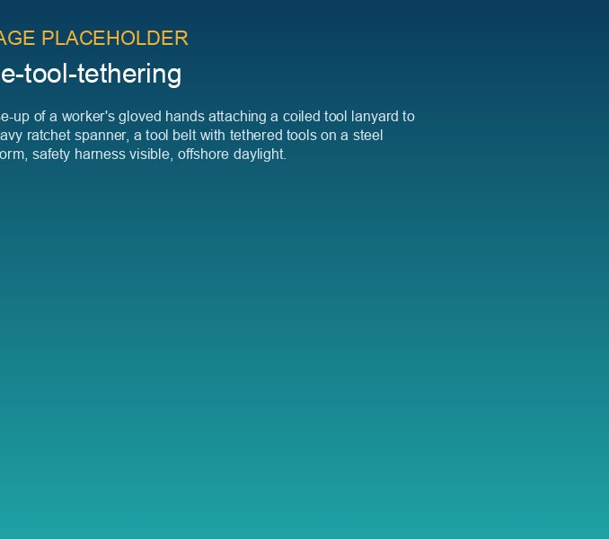
Our rules from today
• Every tool at height is tethered
• Count tools up, count tools down
• Nothing on handrails or kick plates
• Check 'clear above' before moving structures
WEYLAND ENERGY · Toolbox Talk – Dropped Objects
4

Slide 5
Discussion
• Where in your job could something fall?
• What stops you from tethering a tool?
• Who will you challenge – and how?
WEYLAND ENERGY · Toolbox Talk – Dropped Objects
5
Notes:
Let the crew talk. Collect answers on the flip chart and send a photo to HSE.

Slide 6
WEYLAND ENERGY
Stop. Think. Tether.
Report every dropped object – even a bolt

